Slide 1
DRAKEPEDIA DESIGN
FYS 022 – 10.12.2010
jeremy.sievers@drake.edu
x2795

Slide 2
CLIENT CONSTRAINTS:
look of Wikipedia Logo
work with existing designs and developing style guides
including the tagline, “Building a Living Archive”
limitations of template design in WikiSpaces
the pronoun-sea-ation

Slide 3

REFERENCE DESIGN:

Slide 4
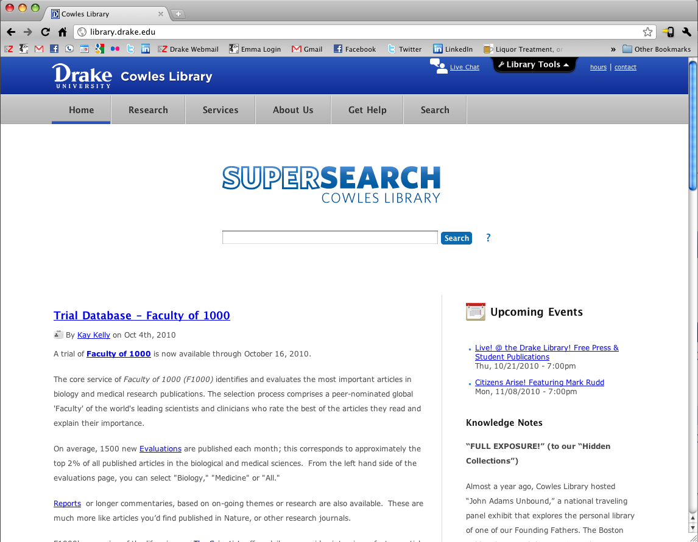

EXISTING STANDARDS:
(Fonts Whitney Book and Whitney Bold)

Slide 5
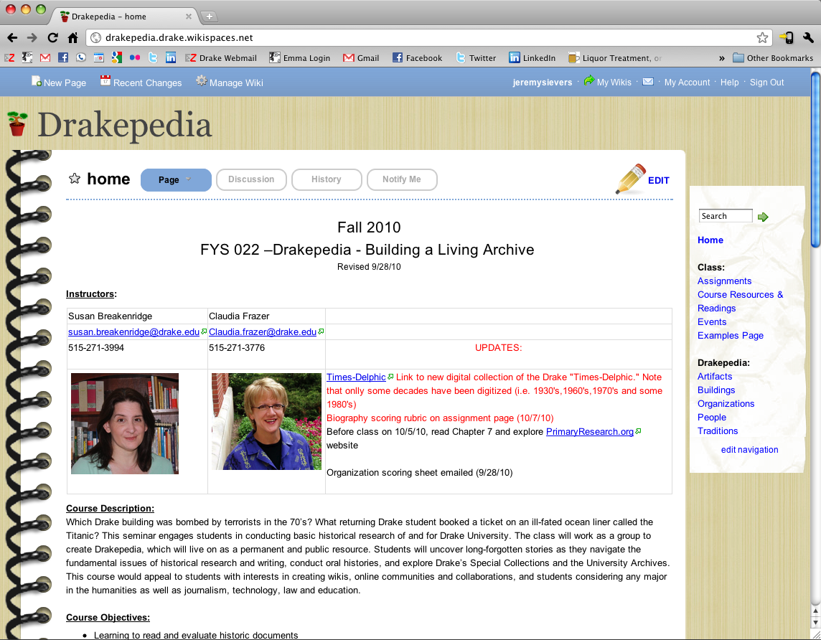
WIKI SPACES LIMITATIONS:

Slide 6
TAGLINE:
“Building a Living Archive”

Slide 7
PRONOUNCING THE UNPRONOUCEABLE:
“drakepedia?”

Slide 8
“drake-pedia”

Slide 9
“drake-a-pedia”

Slide 10
“drakey-pedia”

Slide 11


Slide 12
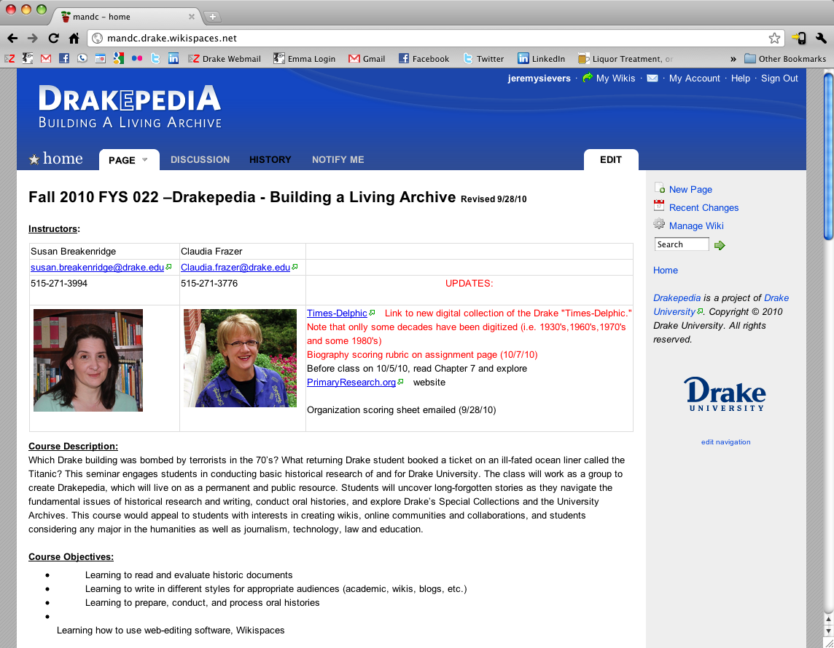
( http://mandc.drake.wikispaces.net/ )

Slide 13
HOW TO IMPLEMENT:
Select Template
Modify Color Template
Swap Custom Logo
Add Sidebar Footer

Slide 14
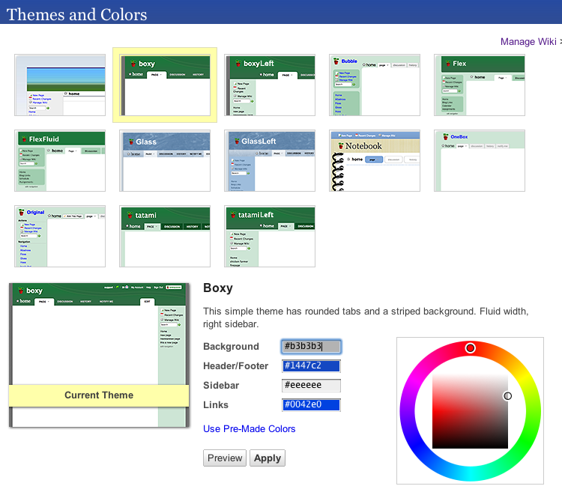

Slide 15

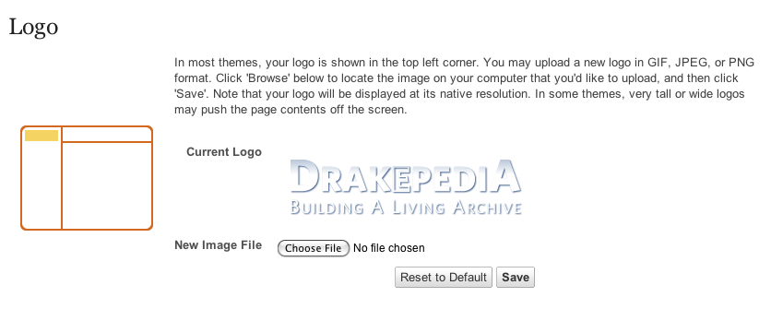

Slide 16
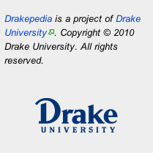
We suggest including a footer with the Drake University primary mark.
The copy is only for an example.

Slide 17
jeremy.sievers@drake.edu
x2795

